Slide 1
Quality in laboratory
Dr. Mehmood-ul-Hassan Malik
MBBS, FCPS (Haematology)
mehmood196@hotmail.com

Slide 2
Objectives:
At the end of this session the participants will be able to:
Define quality.
Describe the basics of Essentials of Quality per WHO.
Interpret LJ chart.
Describe troubleshooting in IQC & PT.

Slide 3
Some terminologies:
CLIA: Clinical Laboratory Improvement Amendments
CLSI: Clinical & Laboratory Standards Institute
CV: Coefficient of variation
EQA: External quality assessment
IQC: Internal quality control
ISO: International Organization for Standardization
PT: Proficiency testing
QA: Quality assurance
SD: Standard deviation
WHO: World health organisation

Slide 4

What is quality?
Accuracy, Reliability and Timeliness of reported test results.
(Laboratory Quality Management System, WHO. 2011)
IMPORTANCE OF LAB DIAGNOSTIC SERVICES:
At least 80% of guidelines which are aimed at establishing a diagnosis or managing disease require laboratory testing.
Review Article: Enhancing the Clinical Value of Medical Laboratory Testing Kenneth A Sikaris Sonic Healthcare, Melbourne Pathology, Collingwood, Vic. 3066, Australia

Slide 5


A. WHAT IS ACCURACY?
Closeness to the true value
Expressed as More or Less Accurate by using Percent error.
The lower the percent error, the more accurate the measuring device.

Slide 6
Why accurate results?
To avoid:
unnecessary treatment
treatment complications
failure to provide the proper treatment
delay in correct diagnosis
additional and unnecessary diagnostic testing
legal suit against the laboratory

Slide 7
B. WHAT IS PRECISION?
Closeness among repeated values.
Described as low or high precision by using Coefficient of variation.
The lower the standard deviation, the more precise that measuring device is.
CV minimizes apparent differences in SD of two data sets, while SD is used more often to measure the spread of values in a single data set.
.

Slide 8
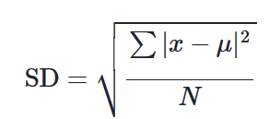
Manual calculation:
where Σ means "sum of“, is a value in the data set, µ is the mean of the data set, and N is the number of data points in the population.
Formula in Excel sheet;
On-line calculators.

Slide 9
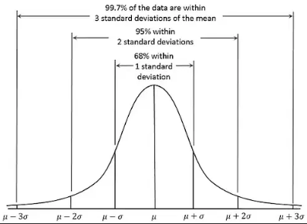
Gaussian/normal distribution:

Slide 10
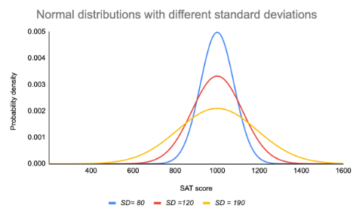

Slide 11
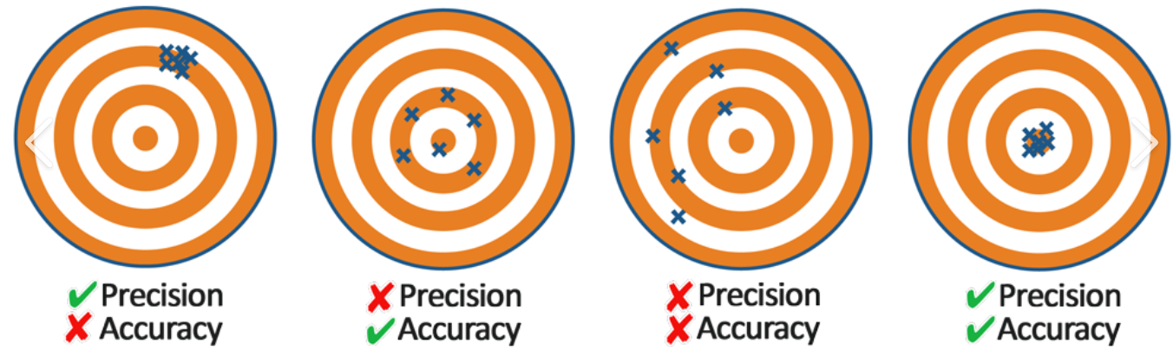

Slide 12

c. Turnaround time:
Time taken from receiving the specimen in the laboratory to releasing the final report.
Make list of TAT for all tests
Record of Monthly Data of TAT for each test
Record of Request forms and Reports depicting time & date

Slide 13
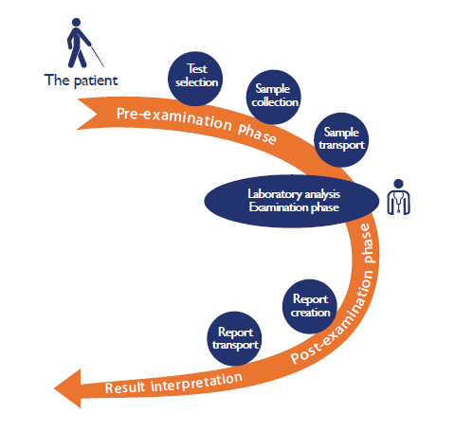
Path of workflow:
Laboratory Quality Management System, WHO. p.12

Slide 14
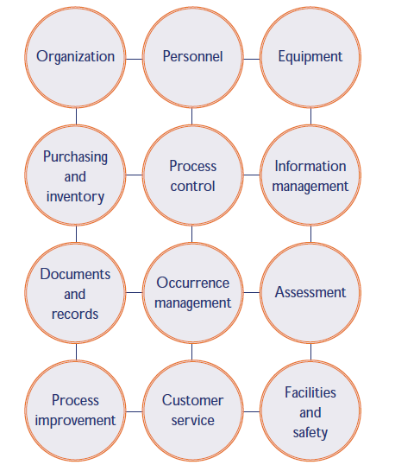
Quality system essentials:
The quality model used here organizes all of the laboratory activities into 12 quality system essentials.
CLSI/NCCLS. A quality management system model for health care; approved guideline—second edition, CLSI/NCCLS document HS1-A2. Wayne, PA, NCCLS, 2004.
Approaches to implementation will vary with the local situation.
Laboratories not implementing a good quality management system are guaranteed that there will be many errors and problems occurring that may go undetected.
Laboratory Quality Management System, WHO. p.7

Slide 15

1. Organization:
In order to have a functioning quality management system, the structure and management of the laboratory must be organized so that quality policies can be established and implemented. There must be a strong supporting organizational structure—management commitment is crucial—and there must be a mechanism for implementation and monitoring.

Slide 16
2. personnel:
The most important laboratory resource is competent & motivated staff. The quality management system addresses many elements of personnel management and oversight, and reminds us of the importance of encouragement and motivation.

Slide 17
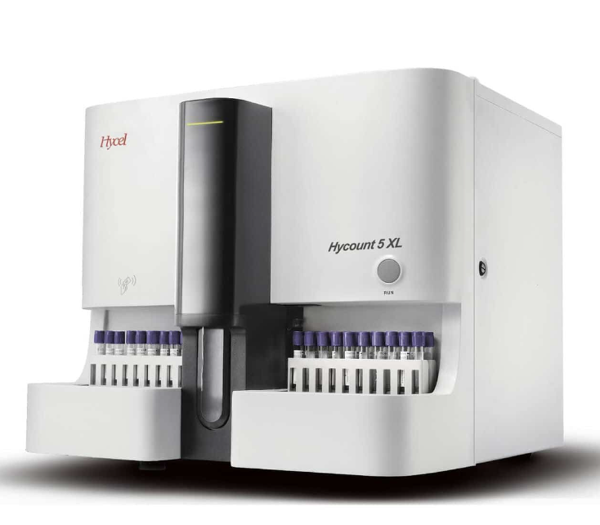
3. equipment:
Many kinds of equipment are used in the laboratory, and each piece of equipment must be functioning properly. Choosing the right equipment, installing it correctly, ensuring that new equipment works properly, and having a system for maintenance are all part of the equipment management programme in a quality management system.
Validation/Verification
Daily, Weekly, Monthly, Yearly maintenance plan
Planned preventive maintenance (PPM)
Equipment Inventory
Manuals and Logs

Slide 18
VALIDATION (by manufacturer):
Confirmation, by the examination and the provision of objective evidence, that the particular requirements for a specific intended use are fulfilled.
ISO/IEC 17025:2005. General requirements for the competence of testing and calibration laboratories.
VERIFICATION (by lab) :
Confirmation, through provision of objective evidence, that specified requirements have been fulfilled.
ISO 15198:2004.

Slide 19
Verification:
Verification of an FDA-approved method includes 4 studies*:
Precision (agreement between repeated values) [CLSI EP15-A3, 2 samples x 5 times x 5d]
Accuracy (agreement between measured value to true value) &
Comparison [CLSI EP24-A2, 40 samples x duplicate x 5d]
Reference Range [CLSI C28-A3, Published data verified on 90% of ≥20 samples/ experiment on120 healthy reference subjects]
Number of parametres depends upon purpose of study and discretion of lab manager.
Parametres for validation are a longer list.*
The data is analysed using a statistical tool eg EP evaluator
*College of American Pathologists (documents-cloud.cap.org)

Slide 20
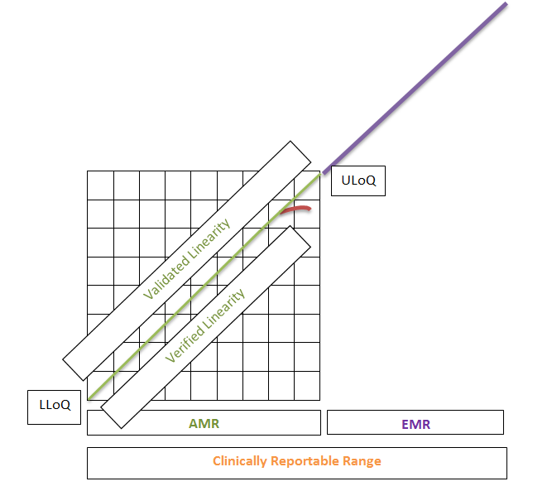
Linearity/Analytical Measuring range (range of analyte concentrations that can directly measure without dilution, concentration, pretreatment) [CLSI EP17, 5 samples x 2 methods]
(Clinically Reportable Range: AMR+Extended MR after dilution)

Slide 21
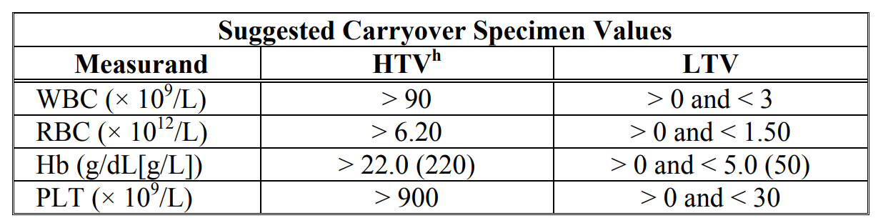
Carry-over (contamination of a sample by the sample analysed immediately preceding it)
CLSI H26-A2
% Carry-over = LTV1-LTV3/(HTV3-LTV3) x 100
Fresh whole blood samples with elevated “high target value” (HTV) concentrations are processed in triplicate, followed by three aspirations of fresh whole blood “low target value” (LTV) specimens.
Using a automated analyser, a Carry-over is suspected when a clinically discordant result is reported and which has been run with a higher preceding sample. Improper pipetting probe washing after first sampling is the aetiology.

Slide 22
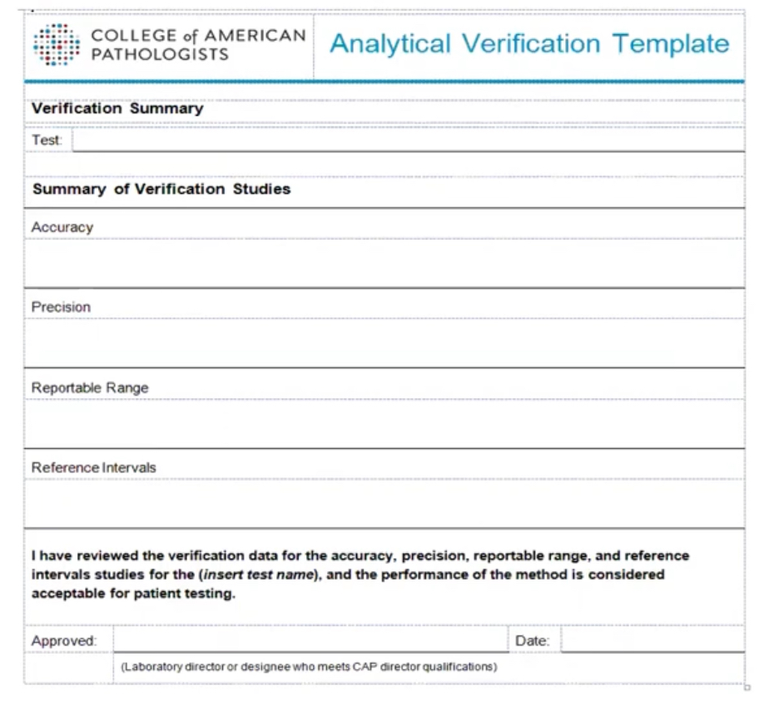

Slide 23

4. Purchasing & inventory:
The management of reagents and supplies in the laboratory is often a challenging task. The procedures that are a part of management of purchasing and inventory are designed to ensure that all reagents and supplies are of good quality, and that they are used and stored in a manner that preserves integrity and reliability.
Analyse needs
Price versus Quality
Storage conditions
Maintain inventory (computerized)
Monitor Expiry date
Track materials

Slide 24
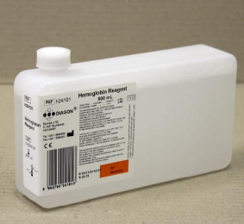
Receiving a new reagent:
Identify
Lot #
Expiry
Integrity
Storage condition
Lot-to-lot verification (LTLV)
- Samples (controls + patient)
- Compare old and new lot
Acceptance criteria:
<TEa (eg WBC 15%, RBC 6%, Hb 7%, Plt 24%)
Limits of TEa are mentioned on CLIA website.

Slide 25
Troubleshooting ltlv:
If LTLV is found unacceptable, follow these steps before rejecting that lot of reagent:
Exclude Calibration issue
Exclude if either of low or high specimen was degraded
Exclude if Interfering substances affected specimens
Exclude mistake in acceptance criteria
Exclude mistake in any calculations
If any of these issues found, correct that, and re-test LTLV.
If still same issue, reject. Otherwise accept the lot.

Slide 26

5. Process control:
Process control is comprised of several factors that are important in ensuring the quality of the laboratory testing processes. These factors include quality control for testing, appropriate management of the sample, including collection and handling, and method verification and validation.
Lab Handbook
Sample collection
Rejection
Sample transport
Sample processing
Sample storage

Slide 27
Quality control:
Regardless of the type of examination that is performed, steps for implementing and maintaining a QC programme include:
establishing written policies and SOPs, including corrective actions;
assign responsibility for monitoring;
training all laboratory staff;
selecting good QC material;
establishing ranges;
developing graphs;
reviewing quality control data;
ensuring complete documentation;

Slide 28
Control versus calibrator
Controls are substances that contain an approximate amount of the substance being tested—the analyte. Controls are tested in the same way as patient samples. Their purpose is to monitor primarily precision of method. They are not traceable.
It is important not to confuse calibrators and control materials. Calibrators are solutions which are traceable to International standards with a specified defined concentration that are used to set or calibrate an instrument, kit, or system before testing is begun. Calibrators are often provided by the manufacturer of an instrument. They should not be used as controls since they are used to set the instrument. Calibrators are sometimes called standards, but the term calibrator is preferred. They usually do not have the same consistency as patients’ samples.

Slide 29
Internal quality control:
Types: Unassayed/In-house/Assayed/▲Third-party
Levels: At Clinical decision limit (L1: Abnormal low, L2: Normal, L3: Abnormal high).
At least 2 levels [CLSI 24-A3]
Instructions
Storage
Process
Run as Control sample
LJ chart data entry
Analyse
Record keeping

Slide 30
RUN: (Batch of tests performed over a time)
- WITHIN RUN: Within one batch eg morning
- ACROSS RUN: Between two batches eg morning & evening
MATERIAL: (Level of control)
- WITHIN MATERIAL: Within one level eg Level 1
- ACROSS MATERIAL: Between two levels eg Level 1 & 2

Slide 31
The Maximum run of Controls is 8 hours in Haematology (CLIA).
According to Westgard, the frequency is determined by consideration of either:
BATCH TESTING:
Controls are run at the beginning and at the end.
CONTINUOUS TESTING (Yago and Alcover relationship):
Measurement procedure imprecision;
Detectability of error by IQC strategy;
Reagent stability;
Cost of patient lookback;
Severity of harm to patient by undetected error;
Probability & Frequency of quality control failures; and
Variability of testing personnel.

Slide 32
Quantitative examinations measure the quantity of an analyte present in the sample. The measurement produces a numeric value as an end-point, expressed in a particular unit. Example: Hb reported as 14 g/dL. ► Quantitative controls.
Qualitative examinations are those that measure the presence or absence of a substance, or evaluate cellular characteristics. The results are not expressed in numerical terms, but in qualitative terms eg “positive” or “negative”; “reactive” or “non-reactive”; “normal” or “abnormal”. Examples: Staining, Blood grouping, Rapid test devices. ► Positive/Negative controls.
Semiquantitative examinations: The results of these tests are expressed as an estimate of how much of the measured substance is present. Results might be expressed in terms such as “mild, moderate amount”, or “1+, 2+, or 3+” or “%”. Example: Morphology, Electrophoresis, Antibody titre. ► Specimens of known value.

Slide 33
QC for (semi-)qualitative tests:
Conducting QC for many of these tests is not as easily accomplished as with quantitative tests; other processes within the quality system are carefully conducted, in addition to traditional QC methods.
Sample management;
Dedicated, professional staff;
Incubators, refrigerators, microscopes, autoclaves and other equipment must be maintained and monitored carefully;
Positive and negative controls must be used to monitor the effectiveness of test procedures that use special stains or reagents and tests with end-points such as agglutination, colour change or other non-numeric results.
Reagents should be stored according to the manufacturer’s instructions, labelled with the date they are opened and put into use, and discarded at the expiration date
Keeping records of all QC processes and corrective actions.

Slide 34
iQC protocol:
Determine frequency of running Controls.
Statistical QC procedure:
- If all control levels are within 2 SD limit, accept the run and report test results of the patients.
- Use Single rule: 1_{3S} as a Rejection rule, while 1_{2S} as Warning rule.
- After finding a Warning rule, inspect data for Multirule violations: R_{4S}/2_{2S}/4_{1S}/10_{x}/7_{T} as Rejection rules with 2 controls per run, and 2of3_{2S}, 3_{1S}, 6_{x} as Rejection rules with 3 controls per run.
Use a Multirule procedure only if a Warning is seen.
Inspect for Within-run, Across-run, Within-material & Across-material results.
Don’t use a control value which is already consumed in interpreting a rejection rule.

Slide 35
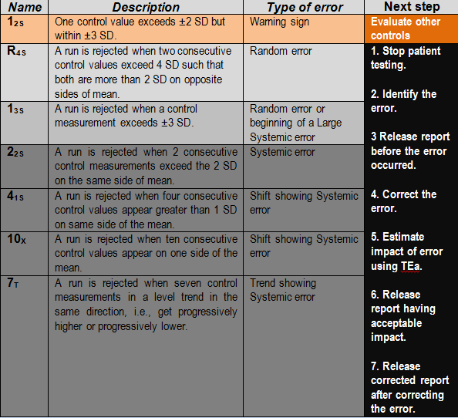

Slide 36

 | _{Run} | _{Run}
_{Level 1} | 1_{3S} | In control
_{Level 2} | In control | In control

Slide 37
R_{4S} across material within run
 | _{Run} | _{Run}
_{Level 1} | +2SD | In control
_{Level 2} | -2SD | In control

Slide 38
2_{2s}
 | Run | Run
Level 1 across run, within material | -2SD | -2SD
Level 2 | In control | In control
 | Run | Run
Level 1 across run, within material | +2SD | +2SD
Level 2 | In control | In control
 | Within Run, Across material | Run
Level 1 | -2SD | In control
Level 2 | -2SD | In control
 | Within Run, Across material | Run
Level 1 | +2SD | In control
Level 2 | +2SD | In control

Slide 39
4_{1s}
 | Run | Run | Run | Run
Level 1 Across run, within material | +1SD | +1SD | +1SD | +1SD
Level 2 | In control | In control | In control | In control
Across un, across material | Run | Run
Level 2 | +1SD | +1SD
Level 1 | +1SD | +1SD
 | Run | Run | Run | Run
Level 1 Across run, within material | -1SD | -1SD | -1SD | -1SD
Level 2 | In control | In control | In control | In control
Across un, across material | Run | Run
Level 2 | -1SD | -1SD
Level 1 | -1SD | -1SD

Slide 40
 | Run | Run | Run | Run | Run | Run | Run | Run | Run | Run
Level 1 Across run, within material | +x | +x | +x | +x | +x | +x | +x | +x | +x | +x
Level 2 | In control | In control | In control | In control | In control | In control | In control | In control | In control | In control
 | Run | Run | Run | Run | Run | Run | Run | Run | Run | Run
Level 1 Across run, within material | -x | -x | -x | -x | -x | -x | -x | -x | -x | -x
Level 2 | In control | In control | In control | In control | In control | In control | In control | In control | In control | In control

Slide 41
Across run, across material | Run | Run | Run | Run | Run
Level 1 | +x | +x | +x | +x | +x
Level 2 | +x | +x | +x | +x | +x
Across run, across material | Run | Run | Run | Run | Run
Level 1 | -x | -x | -x | -x | -x
Level 2 | -x | -x | -x | -x | -x

Slide 42
How to construct an LJ chart:
Built-in feature of new analysers.
Constructed using Excel sheet.
Constructed for each test at each level on a hard copy of a graph
paper:
- Run 20 controls over 20 days [CLSI 24-A3 guidelines]
- Measure Mean and SD.
- Label a graph for the analyte, control level, control lot #, month, initials.
- Plot values of -3SD, -2SD, -1SD, Mean, +1SD, +2SD, +3SD, in an
ascending order on Y-axis at equal distance.
- Plot time of running the control eg in Days on X-axis.
- Join two lines drawn from the day and from the control result and
mark a circle where these two intersect. Join consecutive circles with a
straight line.

Slide 43
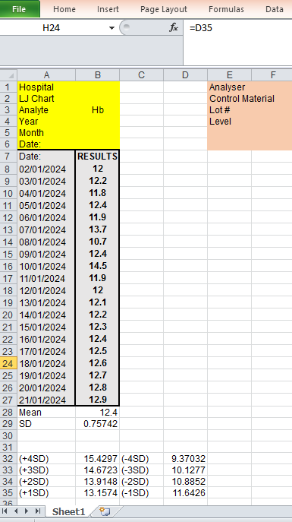

Slide 45
Quiz:

Slide 46
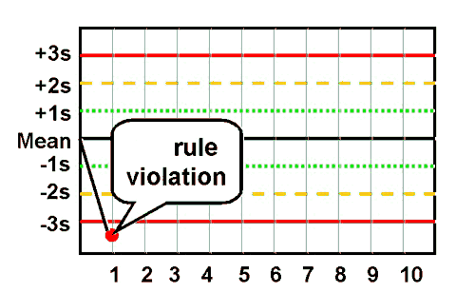

Slide 47
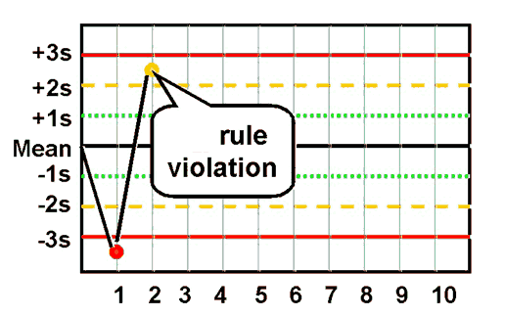

Slide 48
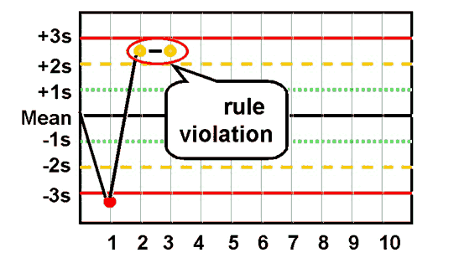

Slide 49
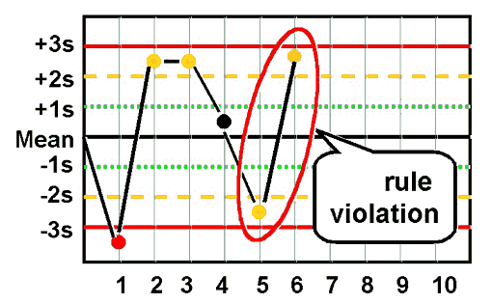

Slide 50
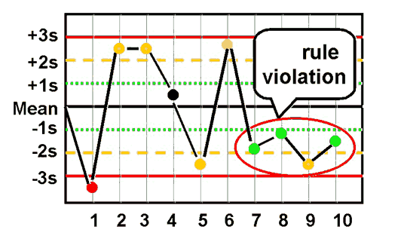

Slide 51
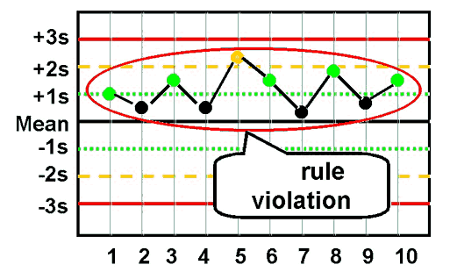

Slide 52
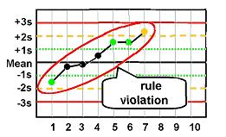
Coutersy: Westgard QC (www.westgard.com)

Slide 53
Random vs systematic error:
Why to type an error?
What are the types of error detected by IQC?
 | Random |  | Systematic
Definition | Unpredictable event without direction |  | Predictable event with direction
Significance | Chances of recurrence are unknown |  | Chances of recurrence are known
 | Specific cause |  | Specific cause
 | Effect on patient's result is unknown |  | Effect on patient's result is known
When you can't miss it? | 1_{3S}
Can the error hide? | Yes |  | Yes
Clarity: | Unclear when using single rule | Clear | Unclear when using single rule
When? | When value is within 3SD |  | When value is within 3SD
Using other rules? | R_{4S} |  | 2_{2S}, 4_{1S}, 10_{X}, 7_{T}

Slide 54
Troubleshooting iqc errors:
 |  | 1_{3S}, R_{4S} | 2_{2S}, 4_{1S}, 10_{X}, 7_{T}
CONTROL: | Identity: | Interchanged control identity | Incorrect reference values
 | Homogeneity: | Poor homogeneity | Improper preparation
 | Volume: | Insufficient volume
 | Quality: | Temperature change | Expired
 |  |  | Hemolysis
 | Contamination: | Aspirate line block | Mixing two controls
OPERATOR: | SOP: | Failure to follow manufacturer’s instructions once | Failure to follow manufacturer’s instructions continuously
 |  | Operator shortcut once | Operator shortcut continuously
 | Preparation: | Poor pipetting technique once
REAGENT: | Homogeneity: | Improper mixing | Improperly prepared reagent
 | Volume: |  | Insufficient reagent
 | Identity: |  | Incorrectly installed reagent
 | Quality: |  | Storage at improper temperature
 |  |  | Unverified reagent of new lot
 |  |  | Out of stability period
 | Contamination: |  | Mixing with other chemicals
ANALYSER: | Contamination: | Air bubble in lines | High background count
 | Reaction chamber: |  | Temperature change in reaction chamber
 | Calibration: |  | Wrong calibration
 |  |  | Deteriorating calibration
 |  |  | Delayed maintenance
 |  |  | Incorrect maintenance
 | Electricity: | Temporary Fluctuation | Deterioration in light source
OTHERS: | Glassware: | Dirt
 | Pipette: | Clogged | Deteriorating calibration of pipette
 |  | Imprecise
 |  | Bubble
 | Environment: | Temperature variation | Temperature variation
 |  |  | Humidity

Slide 55
What next after detecting error:
Correct the cause.
Re-run controls:
- If within control, accept IQC values.
- If still out of control, continue troubleshooting.
■ What about previous patient results:
- Error affecting only control:
- Continue testing.
- ▲ Release previous reports.
- Error affecting patient results too:
- If time of error known: ▲ Release patients reports prior to the time of error.
For reports generated after the time of error, evaluate impact of error.
- If time unknown: Hold all reports since last in-control result.
- Stop testing on this instrument; but continue on other instrument.
- Evaluate impact of error by repeating patient samples testing after error correction.
- Difference < TEa: ▲ Release previous reports;
- Difference > TEa: ▲ Release only the corrected reports; Recall released reports.
Implement preventive action.

Slide 56
External quality assessment:
A system for objectively checking the laboratory’s performance using an external agency or facility .
Proficiency testing—external provider (RIQAS, NEQAS, CAP, EQAAS, NEQAPP) sends unknown samples to a set of laboratories, and the results of all laboratories are analyzed, compared and reported to the participant laboratories.
Rechecking or retesting—slides that have been read are rechecked by a reference laboratory; samples that have been analyzed are retested, allowing for inter-laboratory comparison.
On-site evaluation—usually done when it is difficult to conduct traditional proficiency testing or to use the rechecking/retesting method.

Slide 57
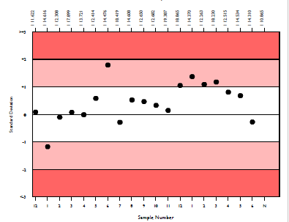
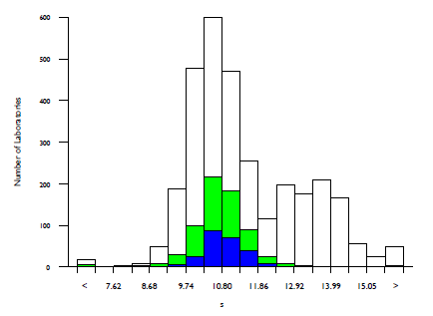
Proficiency testing allows:
Provision of inter-laboratory comparison
Comparison between different analytical methods
Initiation and evaluation of corrective actions.
Provision of objective view of test system performance
Meaningful continuous monitoring of previous data

Slide 58
Proficiency testing (PT):
Registration
Specimen reception
Instructions
Save specimens as directed
Verify Schedule of submission of results
Run as patient sample by routine operator on primary analyser
Upload data
Receive result
Troubleshooting (if needed)
Record keeping
Don’ts: Best tech/Repeats/Cross-check/Different instrument/Split

Slide 59
Selection of assigned value:
Results are evaluated by comparing them to a mean for comparison, which is based on consensus (data from participants).
All participants are registered on each programme according to their chosen parametre, method, instrument, unit.
Results > 5: instrument group statistics
Results < 5 in your instrument: registered method group mean
Results <5 in your method: all methods mean

Slide 60
Acceptable performance:
Criteria for acceptable performance is mentioned in the instructions provided with individual programme,
Result is analysed as follows:
QUANTITATIVE DATA:
For Gaussian distribution:
- Standard deviation index (SDI): <2
- Target score (TS): >50
- Percentage deviation (% Dev)
For non-Gaussian distribution:
- Ranks
QUALITATIVE DATA:
- Comparative numbers

Slide 61
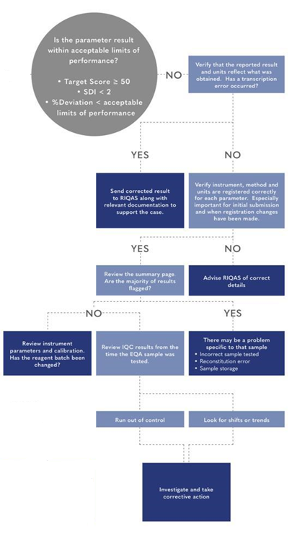

Slide 62
Most of the persistently Out of Consensus results are due to:
Extra-analytical factors:
- Incorrect registration/peer group selection
- Incorrect units/clerical errors
- Delayed shipment/storage
- Delayed result performance/reporting
- Reconstitution mistakes
Analytical factors:
- Poor calibration
- Changed reagents (New or non-dedicated)
- Changed instrument
Failure to review last evaluation
.

Slide 63
The corrective and preventive action process
Reviewing and defining the problem or non-conformity.
Finding the cause of problem.
Develop an action plan to correct the problem and prevent the recurrence.
Implementing the plan.
Evaluating the effectiveness of the correction in preventing the problem.

Slide 64
6. Information management:
The product of the laboratory is information, primarily in the form of test reporting. Information (data) needs to be carefully managed to ensure accuracy and confidentiality, as well as accessibility to the laboratory staff and to the health care providers. Information may be managed and conveyed with either paper systems or with computers; both will be discussed in the section on information management.

Slide 65

7. Documents and records:
Documents are needed in the laboratory to inform how to do things, and laboratories always have many documents eg SOPs, Quality Manuals, Reference Materials. Records must be meticulously maintained so as to be accurate and accessible.

Slide 66
8. Occurrence management:
An “occurrence” is an error or an event that should not have happened. A system is needed to detect these problems or occurrences, to handle them properly, and to learn from mistakes and take action so that they do not happen again.
Pre-examination errors
Examination errors
Post-examination erros
Occurrence Report Form

Slide 67

9. assessment:
The process of assessment is a tool for examining laboratory performance and comparing it to standards, benchmarks or the performance of other laboratories.
Internal:
- performed within the laboratory using its own staff
- at least once a year {ISO 15189:2007 [4.14.2]
External:
- conducted by a group or agency outside the laboratory.
What is being done?
Is it according to SOP?
Is SOP according to Standards?

Slide 68
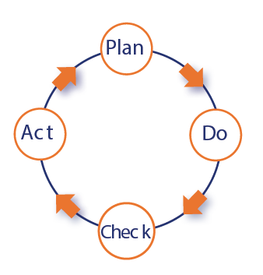
10. Process improvement:
The primary goal in a quality management system is continuous improvement of the laboratory processes, and this must be done in a systematic manner.

Slide 69

11. Customer service:
The concept of customer service has often been overlooked in laboratory practice. However, it is important to note that the laboratory is a service organization; therefore, it is essential that clients of the laboratory receive what they need. The laboratory should understand who the customers are, and should assess their needs and use customer feedback for making improvements.
Complaint monitoring
Customer surveys

Slide 70
12. Facilities and safety:
Security—which is the process of preventing unwanted risks and hazards from entering the laboratory space.
Containment—which seeks to minimize risks and prevent hazards from leaving the laboratory space and causing harm to the community.
Safety—which includes policies and procedures to prevent harm to workers, visitors and the community.
Ergonomics—which addresses facility and equipment adaptation to allow safe and healthy working conditions at the laboratory site.

Slide 71
Case 1:
You have joined a lab where no IQC is established. You request new IQC controls. In addition to IQC, how will you augment quality control in the lab?
Correlation check (WBC/Hb/MCV/Plt with Smear & History)
Delta check (˂CV of instrument+Biological Variation)
Moving averages (>300 specimens ±3% of MCH,MCHC)
Duplicate patient testing (<2SD from 10 duplicates)
Regular maintenance of instrument

Slide 72
Case 2:
Your senior lab technician, trying to help you, has run Calibrator in place of control. What will you do?
Award him employee of the month
Educate him
Fire him
Record this event

Slide 73
Case 3:
You receive controls after a month but their date of expiry has passed by one day. What will you do?
Change expiry date of controls and run
Inform your seniors
Run the control anyway
Stop testing patients samples

Slide 74
Case 4:
Your senior advises you to lend controls from nearby laboratory. You receive Level 3, and run. It shows following results:
WBC: 15 x 10³/µL, RBC: 1.0 x 10⁶/µL, Hb: 17.0 g/dL, Hct: 9.2 L/L, MCV: 92 fL, MCH: 170 pg, MCHC: 184 g/dL, Plt: 460 x 10³/µL.
Will you accept this control? What did you miss at reception?

Slide 75
Case 5:
You request your vendor to find controls from someone. You receive only one level, and run it. Result shows a -2.5 SD value for Hb; other parametres are within ±2 SD.
What will you do?

Slide 76
CASE 6:
Luckily, next day, you receive commercially prepared Level 1 & 2 controls. You have no previous data of control limits.
How will you determine Mean and SD of these new control?

Slide 77
Case 7:
You run Level 1 Control showing a value of -2.1SD for Plt. What will you do?
Re-run the control
Reject the run
See other levels
Start running tests.

Slide 78
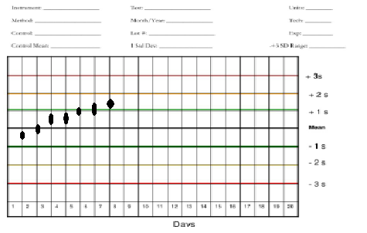
CASE 8:
Today is the 7th day of running IQC. Your technician is cheerful at results of all IQC levels being within ±2SD but you have detected something. Which Westgard rule is about to be violated?

Slide 79
CASE 9:
How will you interpret the Prothrombin time (PT) control results for the current control run (if the ±2SD control limits are 11.80–14.20 seconds for Control N, and 25.00–28.00 seconds for Control P)?
Control N 11.6 seconds
Control P 24.6 seconds
1. Accept the run
2. Reject the run

Slide 80
Case 10:
What is an appropriate method to assess a laboratory operator’s COMPETENCY in performing prothrombin time (PT) and activated partial thromboplastin time (APTT) using an automated coagulation instrument?
Blinded pre-analyzed samples
Direct observing him via checklist
Recommendation by fellow technicians
Reviewing his years of experience
Taking his viva

Slide 81
Take home message:
Quality in lab depends on an holistic management
from specimen to report.

Slide 82
References & recommendations:
1. Laboratory Quality Management System by WHO. https://www.who.int/publications-detail-redirect/9789241548274
2. ISO International Organisation for Standardisation www.iso.org
3. CLSI Clinical and Laboratory Standards Institute www.clsi.org
4. Westgard QC www.westgard.com
5. CDC: https://www.cdc.gov/CLIA
6. CMS: https://www.cms.gov/Regulations-and-Guidance/Legislation/CLIA/index
7. FDA: https://www.accessdata.fda.gov/scripts/cdrh/cfdocs/cfCLIA%20/search.cfm

Slide 83
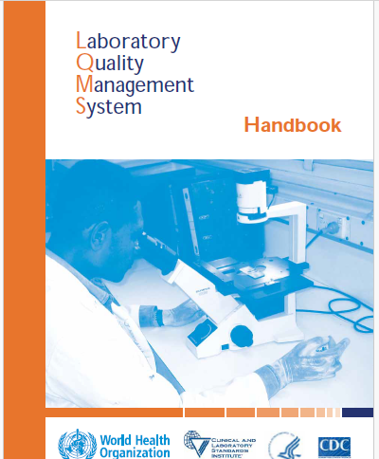
Further read:
This handbook covers topics that are essential for quality management of a public health or clinical laboratory. They are based on both ISO 15189 and CLSI GP26-A3 documents.

